Slide 1
Introduction to Nimbus ML
Place name here

Slide 2
Agenda
About NimbusML
Demos
Action

Slide 3
About NimbusML
NimbusML provides state-of-the-art ML algorithms, transforms and components, aiming to make them useful for all developers, data scientists, and information workers and helpful in all products, services and devices.
The components are authored by the team members, as well as numerous contributors from MSR, CISL, Bing and other teams at Microsoft.
nimbusml is interoperable with scikit-learn estimators and transforms, while adding a suite of highly optimized algorithms written in C++ and C# for speed and performance.

Slide 4
NimbusML Features
NimbusML trainers and transforms support the following data structures for the fit() and transform() methods:
numpy.ndarray
scipy.sparse_cst
pandas.DataFrame.
NimbusML also supports streaming from files without loading the dataset into memory, which allows training on data significantly exceeding memory using FileDataStream.
With FileDataStream, NimbusML is able to handle up to billion features and billions of training examples for select algorithms

Slide 5
Demo
https://aka.ms/ai-nimbusmldemos

Slide 6
Demo
https://github.com/Microsoft/NimbusML

Slide 7


Action

Slide 8
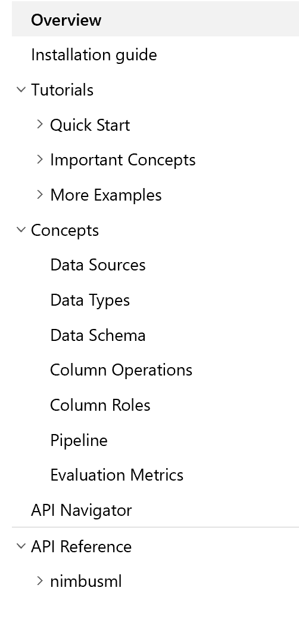

Nimbus ML Documentation
https://docs.microsoft.com/en-us/NimbusML/overview

Slide 9
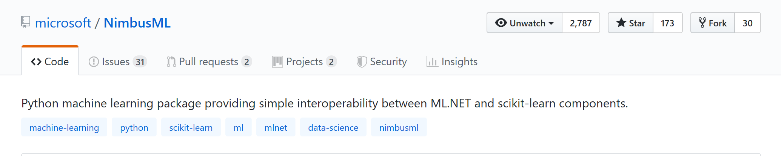

NimbusML on Github
https://github.com/Microsoft/NimbusML

